Slide 1
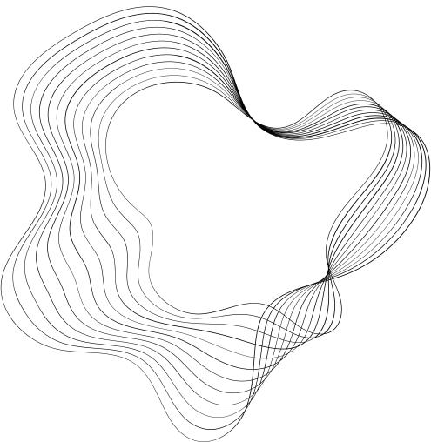

DRONA AVIATION
PLUTO DRONE CHALLENGE

Slide 2

TASK - 1
PYTHON WRAPPER
The pluto class serves as the primary interface for interacting with the Pluto drone. It encapsulates the connection to the drone and provides methods for sending commands and receiving data. Key functionalities within the pluto class typically include:
Connection Establishment: Methods to establish a connection with the drone over Wi-Fi or other communication protocols.
Command Transmission: Functions to send various commands to the drone, such as takeoff, landing, movement, and configuration settings.
Data Reception: Methods to receive data from the drone, including sensor readings, status information, and telemetry data.
Error Handling: Mechanisms to handle potential errors or exceptions that may occur during communication or drone operations.

Slide 3
MSP PACKETS AND KEYBOARD CONTROL
MSP (Micro Serial Protocol) packets are standardized data structures used for communication between the drone and the ground station. They contain information such as the command type, arguments, and a checksum for error detection. The pypluto library likely provides functions for creating, encoding, and decoding MSP packets.
Keyboard control allows the user to interact with the drone directly using a keyboard. It involves mapping specific keys to different commands or actions. For example, pressing the "W" key might make the drone move forward, while pressing the "A" key might make it turn left. The pypluto library might provide a built-in keyboard control mechanism or allow for custom key mappings.

Slide 4
COMMAND GENERATION
The command generation process involves creating MSP packets based on the user's input or predefined commands. This typically involves:
Parsing user input: Interpreting keyboard inputs or other user interactions to determine the desired command.
Creating MSP packet: Constructing the MSP packet with the appropriate command type, arguments, and checksum.
Encoding packet: Encoding the MSP packet into a format suitable for transmission over the communication channel.

Slide 5
PACKET TRANSMISSION AND DRONE RESPONSE
Once the MSP packet is generated, it is transmitted to the drone over the established Wi-Fi connection. This typically involves:
Serializing data: Converting the MSP packet into a byte stream for transmission.
Sending data: Transmitting the byte stream to the drone using the appropriate communication protocol.
Error checking: Implementing mechanisms to detect and handle transmission errors, such as retransmissions or error correction.
The drone receives the MSP packet, decodes it, and processes the commands. The drone's firmware interprets the commands and executes the corresponding actions, such as controlling motors, adjusting flight parameters, or activating sensors.

Slide 6
PID
We use the absolute error between the detected pose and the intended target as the error function. The drone starts fast, and as the error goes down, it slows as expected. Later, as it gets close to the point, the magnitude of commands sent becomes quite low, and the drone moves slowly, especially in roll due to the high derivative, until the integral error takes over and helps the drone to reach the exact point.
The position PID control of the drone is implemented based on the following:
x = kpx(XG - XG') + kix * ∫(XG - XG') dt + kdx(XG - XG)'
y = kpy(YG - YG') + kiy * ∫(YG - YG') dt + kdy(YG - YG)'
z = kpz(ZG - ZG') + kiz * ∫(ZG - ZG') dt + kdz(ZG - ZG)'
θ = kpe(ΘG - ΘG') + kie * ∫(ΘG - ΘG') dt + kde(ΘG - ΘG)'

Slide 7
PID
The position PID control of the drone is implemented based on the following:
x = kpx(XG - XG') + kix * ∫(XG - XG') dt + kdx(XG - XG)'
y = kpy(YG - YG') + kiy * ∫(YG - YG') dt + kdy(YG - YG)'
z = kpz(ZG - ZG') + kiz * ∫(ZG - ZG') dt + kdz(ZG - ZG)'
θ = kpe(ΘG - ΘG') + kie * ∫(ΘG - ΘG') dt + kde(ΘG - ΘG)'
The pitch and roll commands are given by the following:
[P] = [cos(ΘG) sin(ΘG)] [X]
[R] = [-sin(ΘG) cos(ΘG)] [Y]
XG - Desired global X position (pixels)
YG - Desired global Y position (pixels)
ZG - Desired global Z position (m)
ΘG - Desired global Y position (pixels)
P - Pitch command
R - Roll command

